Slide 1
CPCS-352 Research Methodology
Advised by:
Dr. Safiullah Faizullah
Group members:
Mohammed Jamal (362049583)

Slide 2
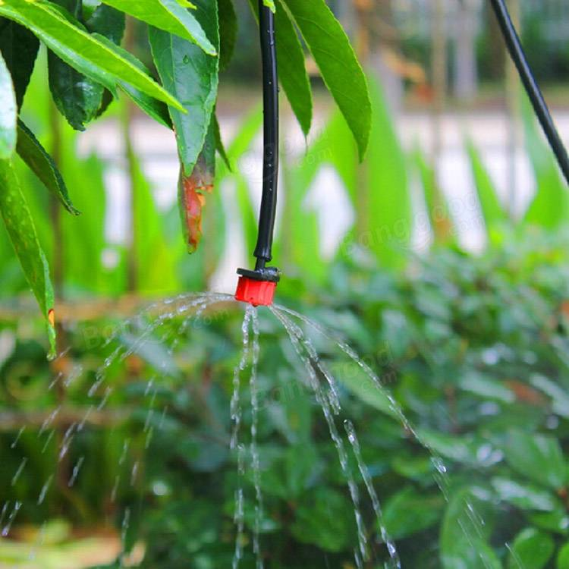
Abstract
We know that people do not pour the water on to the plants in their gardens when they go to vacation or often forget to irrigate plants. As a result, there is a chance to get the plants damaged. Some farmers also irrigate their farms at random way where water consumption significantly. This project is an excellent solution for such kind of problems.
This project aims to help people and farmers to irrigate their plants in a modern and organized manner that helps reduce water consumption and increase plant productivity

Slide 3
Introductions
With two thirds of the earth's surface covered by water and the human body consisting of 75 percent of it, it is evidently clear that water is one of the prime elements responsible for life on earth.
Agriculture plays an essential role in the economic and social development of many countries in the world, especially developing countries, most of which are located in dry areas.
Therefore, the development of agriculture in these countries will play a role in providing food and developing the population of these countries economically and socially

Slide 4
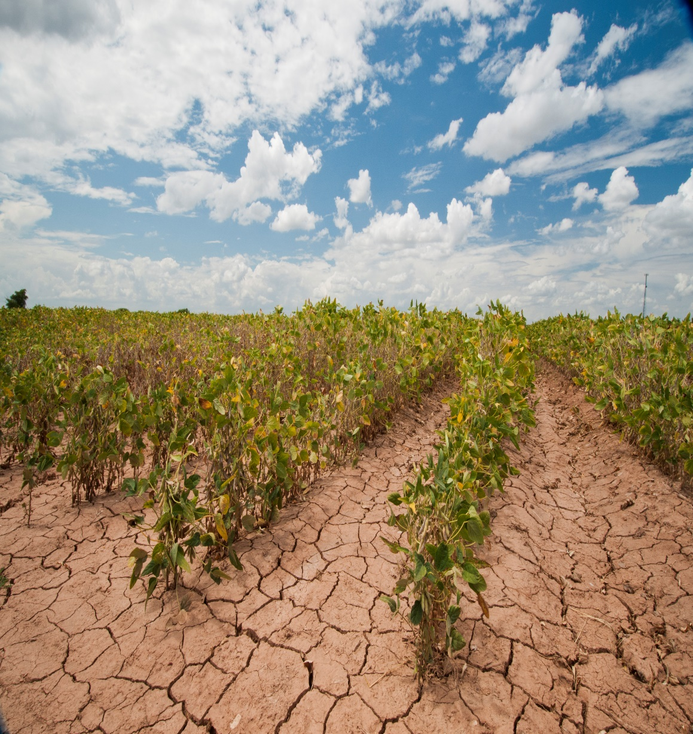
Problem statement
Consumption of a large amount of water when irrigating plants in the traditional way, in addition to the high costs required for irrigation in this manner.
People cannot irrigate their plants and gardens when they are outside the house, which can lead to the death and damage of these plants.

Slide 5
Arguments
There are some important arguments for this project:
Preserving water through irrigation in a modern and organized manner.
Ensure that the plant has sufficient water.
Reduce the costs required for irrigation in the traditional way, such as labor and generator costs.
the possibility of irrigating the plant when you are outside the house.

Slide 6
Aim
Building an application and utilize sensors that helps farmers to irrigate their plants in an easy and economical way that contributes to the preservation of water and to ensure that plants are irrigated in the required quantity.

Slide 7
Objectives
Background
Determine the type of sensors used to measure water temperature and soil moisture.
Financial Feasibility Study. Planning and analysis the hardware and software requirements for the application.
Designing structure and GUI for the application.
Layout of Sensors
Electronic circuit for opening and closing.
Provide hosting for data exchange and remote commands.
Execute and test the application before publishing.
Implementation of the entire system on the farm. (future work)

Slide 8
Methods
Literature Analysis
Implementation
Gathering information

Slide 9
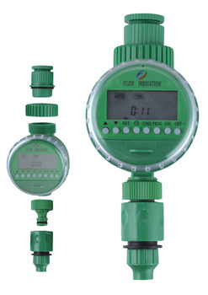
Literature Analysis
there are many irrigation systems used in developed countries, but most of them lack a remote control or wireless feature.
many of electronic irrigation systems is a device connected to the water source and controlled manually, either in our system will be provide with a remote control and reading of the data by application where the user (farmer)can know the temperature of water and soil moisture and open and close the water remotely
The system also sends alerts to the user if the soil moisture ratio is reduced to the required limit.

Slide 10
Literature Analysis
SYSTEM | APPLICATION | ADVANTAGES | LIMITATIONS
Pop-Up Sprinklers | Lawns, bowling, greens, golf courses | Easily Automated, Retract below ground level for mowing | High pressure and discharge may limit the number that can operate at one time
Mini-sprinklers and micro-jets | Shrubs, perennials, trees orchards | Water applied to the specified area with little wastage and low-run-off Operate at low pressure | Easily damaged so use in public is limited Low application rate means that they need to operate for long periods
Drip Tube | Row crops such as cut flowers, vegetables, in ground nursery plants | Inexpensive Efficient (water only applied to the root zone) | Need good filters Not satisfactory for germinating rows of seedlings
External drippers on low density poly pipes | Vineyards, orchards, gardens | Self-compensating types given uniform discharge despite variations in elevation Inexpensive | Need good filters May not wet a big enough percentage of root zone in some situations

Slide 11
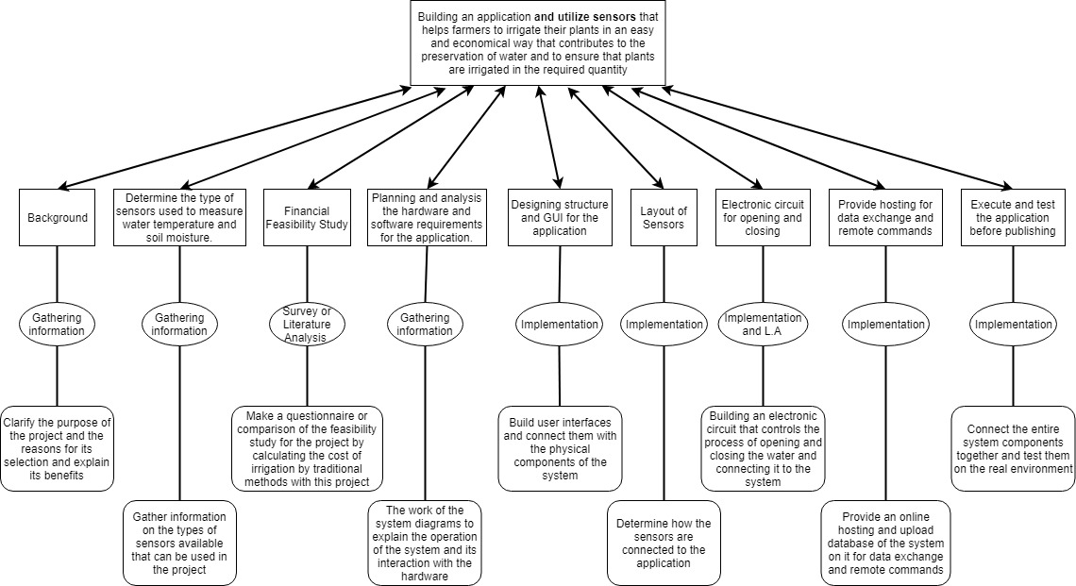
Design of the main work

Slide 12
Financial feasibility study
Globally, the plantation is the largest consumer of water and also consumes 85 percent of the water withdrawn in the Middle East and often the use of water by irrigation is very inefficient
a large quantity of water is consumed without interest, so the cost is very large, on the one hand, and on the other, irrigation by flooding requires large generators. These generators do not have safety standards
Irrigation by flooding also needs workers who supervise it and thus increase the cost in terms of salaries, housing insurance, medical insurance and so on.

Slide 13
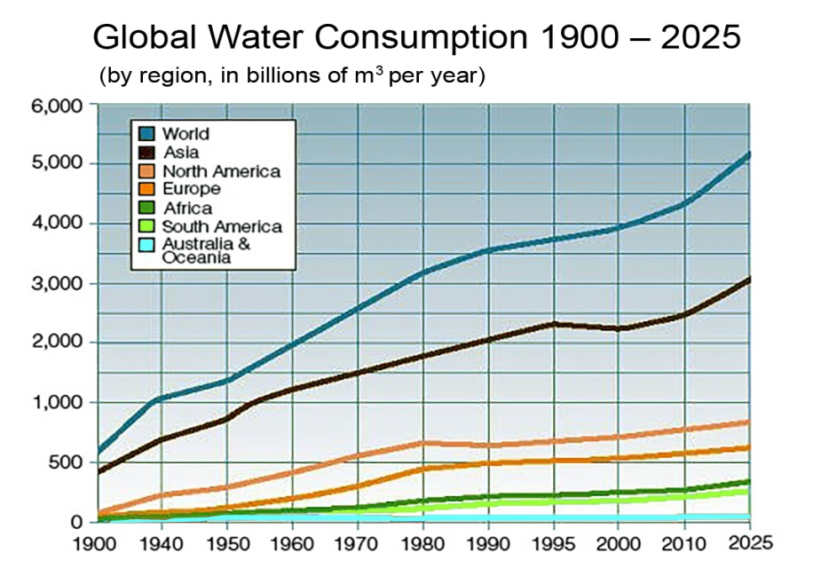
World Water Consumption Statistics
The amount of water withdrawn for irrigation has increased by more than 60 % since 1960.
all available fresh water is used for irrigation in agriculture (70%).
Because of inefficiency in irrigation systems, particularly in developing countries, 60 % of this water is lost in evaporation or returns to rivers and groundwater (United Nations - World Water Assessment Program, 2006: 173)
Water consumption in industrialized countries is up to 380 liters per capita per day in the United States (US Geological Survey, 2004)

Slide 14
World Water Consumption Statistics
Climate/soil | Very rough soil - does not have the power to save water | Sandy soil | Parasitic soil
Hot – dry high evaporation rate in summer | Irrigation is preferred in batches daily. Or once a day while the plant consumes most irrigation water | 1-2 days | 2-3 days
Moderate | Irrigation is preferred in batches daily. Or once a day while the plant consumes most irrigation water | 2-3 days | 3-4 days
cool Low evaporation rate of winter | Irrigation is preferred in batches daily. Or once a day while the plant consumes most irrigation water | 3-4 days (Irrigation twice a week) | 6-8 days (irrigation ones a weak)

Slide 15
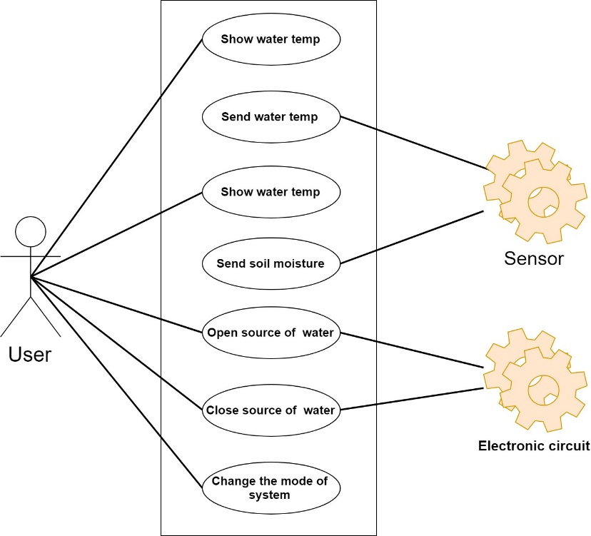
Design the System
After the completion of the planning process is going to the design process.
The following diagrams describe all behaviors and control flow of proposed system

Slide 16
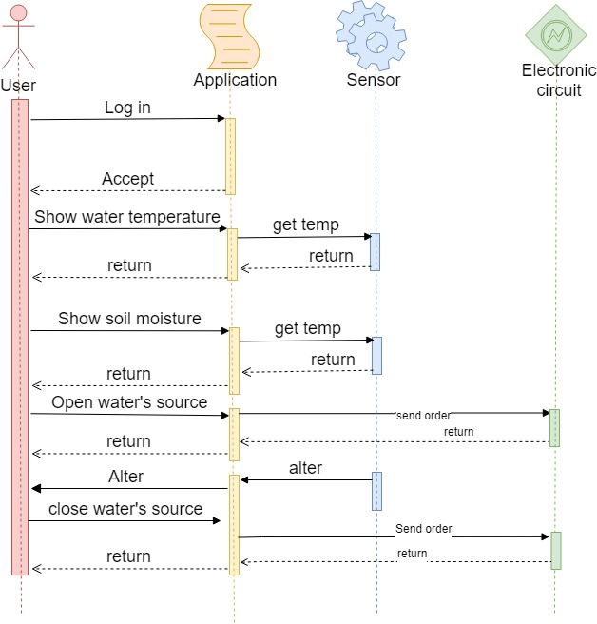
Design the System
This diagram is used to t describes how-and in what order-a group of objects works together.
The user can log into the application and get the measurements of water temperature and soil moisture.
Depending on these measurements, the user sends the order to the circuit to open the water source, and when the humidity reaches the required limit, the sensor sends an alert to the user, then the user sends another order to the circuit to close the water source

Slide 17
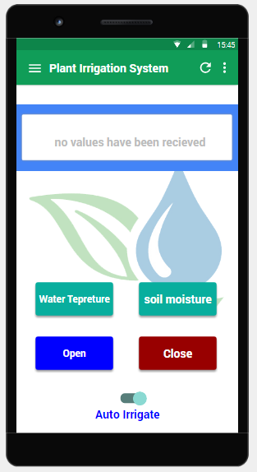
Design the System
The system's main interface contains a screen to show the measurements and four buttons to send commands
The user can also switch the system from manual mode to automatic mode.

Slide 18
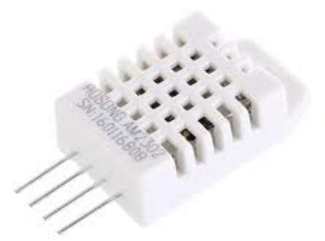
Hardware used
Soil moisture sensors are used for measuring the water content of soil. Multiple soil moisture sensors are combined to form a soil moisture probe
DHT11 and DHT22 sensors are very popular because they are cheap and offer great performance.

Slide 19
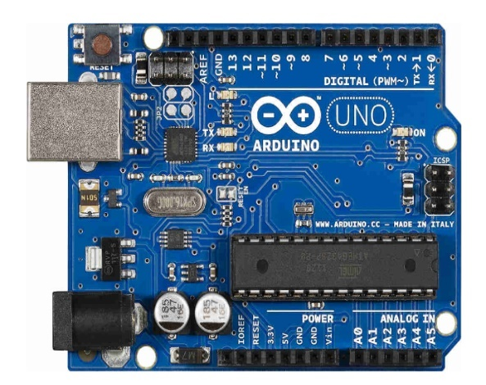
Hardware used
The connection between the sensor and the application will be connected by an electric circuit (Arduino) which will be programmed in C language to do these things so that the sensor sends signals to the (Arduino) which will be processed to send a signal to the application and then the farmer will open the application and press the appropriate command for the operation, To the circuit and then the circuit to be treated and then give the order to the place required

Slide 20
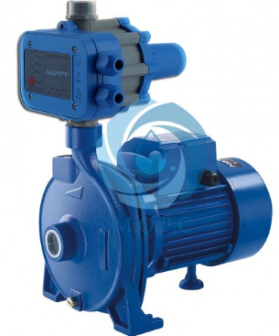
Hardware used
When the soil becomes dry, the sensor sends a signal to the electric circuit (the Arduino), which in turn sends a signal to the application. The farmer will then open the application and press the appropriate command for the operation, which will then be sent to the circuit. Then the circuit will process it and then give it to the sensor to open the pump then pumps water to irrigate the soil

Slide 21

provide hosting

Slide 22
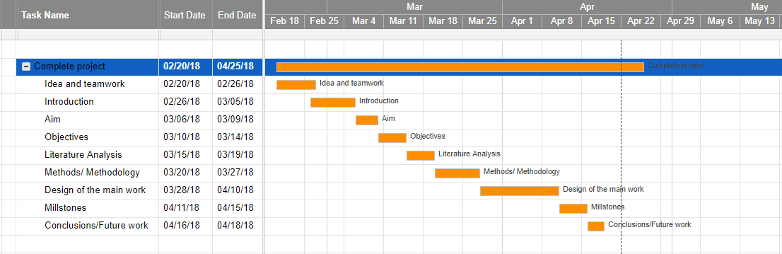
Millstones

Slide 23
Conclusion
We will hope that after we implement this plant irrigation system the percentage of consumption of water definitely will decrease and the productivity of plant will increase.

Slide 24
Future work
In the future we can add more features in our fire detector system and that is:
The possibility of connecting more than one irrigation site to the application.
Add a sensor to measure soil salinity ratio.
Estimating the need for fertilizer and adding it to the water.

Slide 25
References
Local flow regulation and irrigation raise global human water consumption and footprint. Science (December 2015).
Hoekstra, AY (2012). "The Water Footprint of Humanity". PNAS.
http://www.paversearch.com/irrigation-systems-types.htm
https://www.irrigationaustralia.com.au/about-us/types-of-irrigation/types-of-irrigation
Damascus University Journal of Agricultural Sciences (2006) Volume (22) Issue 2 Pages: 427.
http://geeksvalley.com/tutorial/temp-humidity-display/?view=all
https://twinschip.com/index.php?route=pavblog/blog&id=34
https://www.arabsmakers.com
http://geeksvalley.com/tutorial/temp-humidity-display/?view=all
(United Nations - World Water Assessment Program, 2006: 173)
(US Geological Survey, 2004)
http://www.un.org/arabic/waterforlifedecade/factsheet.html
(adwaa kashifa journals 2005:7)
(Henry:Noth , Fundamentals of Land Science book ,1986)
https://www.momra.gov.sa/generalserv/Specs/guid0015.asp
https://bestwebhostingaustralia.net/
https://ar.hostingdean.com/best-hosting/

Slide 26
What We have Learned..
In otherwise we have learned and improved some individual skills like enhance the techniques of information gathering, improve communication skills, learned how to work in a teamwork.
We looking forward to the continuous improvement of what we have learned and work on large projects that contribute to the service of society.

Slide 27
Thank You

